Slide 1

Conducting COOP Exercises for Large Groups
Jamie Hahn, MBCP
Texas Department of Transportation
September 9, 2021

Slide 2
TxDOT’s Operational Structure and COOP Program Deployment
TxDOT operations are divided between 25 districts and 34 divisions. It has 12,500 staff across the state.
2016 Phase 1- Deployed to 16 divisions who are the OPRs of Priority 1-3 RTO processes. (Mission Essential Functions divisions). Also created Pandemic, Devolution and Reconstitution Annexes. Submitted one division plan and exercise to SORM at their request.
2017 Phase II- Deployed to 25 districts. Focused on protecting Mission Essential Functions.
2019 Phase III- Deployed to 34 divisions with “non-essential” processes.

Slide 3
COOP Program Staffing and Management Strategy
The COOP program is managed by 1 full-time employee, the COOP Administrator.
It is centrally managed and coordinated but decentralized in execution through the Division and District Continuity Council (CC) members.
2 Continuity Coordinators per Division/ District. (50 district coordinators and 68 division coordinators)
The Council is the vehicle through which the Administrator organizes and implements all elements of the COOP program across the agency.
It allows the Administrator to deploy within a manageable span of control
The CC members are responsible for all continuity activities within their DD (TxDOT Continuity Council Organizational Charter, Page 2, Roles and Responsibilities)

Slide 4

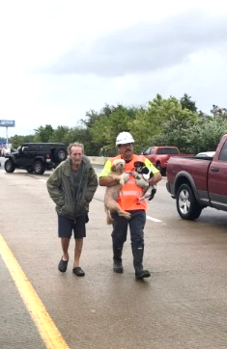
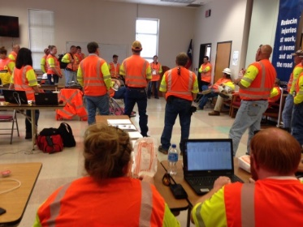
Continuity of Operations Program- Overview
Mission: Continuity of essential operations in all situations, in all circumstances.
Testing and Exercising
Strengthening Agency Continuity Posture
Plan Creation and Maintenance
Program Scope
Administration
25 Districts
34 Divisions
Notes:
COOP program began in March 2016 and completed deployment by December 2016
Program deployed to all Districts by December 2017
Program’s current focus is implementing Hurricane Harvey response lessons learned and continued testing & exercising of plans, updating when necessary

Slide 5
Exercise Steps and Helpful Hints
Select a COOP plan element that hasn’t been exercised and needs to be tested.
Develop the Exercise Toolkit
Schedule Training with the Division Continuity Coordinators (give at least one week’s notice.)
Conduct the training. Make the conversation dynamic; not just you speaking. Ask questions. Prod. Get them engaged.
Record the training session for staff unable to attend. Post recording to SharePoint or other shared folder. Provide the link.
Give 30 days deadline for exercise completion and posting documentation after training.
Be available to answer questions but DO NOT facilitate their exercise. Don’t let them get lazy.

Slide 6
Exercise Toolkits
Exercise Toolkits are an all-in-one tool allowing participants to easily have all aspects of the exercise in a single document. Each toolkit contains 4 tabs at the bottom of the page. These tabs are:
Instructions: Includes an introduction, overview of toolkit contents, exercise rationale, exercise objectives, required documents and assumptions.
Discussion Questions: Introduces the scenario and walks participants through critical questions they must answer.
Observer Notes: Allows an observer to capture participants discussion points/ issues as they happen.
AAR/ Corrective Action Plans: Asks participants to grade themselves on their ability to effectively execute that part of their COOP plan. It also asks key questions on improvement, timeline and point of contact.
Critical Roles: Facilitator, Observer, Division leadership, other participants.

Slide 7
Alternative Facility Strategy Toolkit Review
COOP exercise should test the actionability/ executability of the COOP plan. Is it operationalized? Does it work?
Previous exercises have included: Call Trees, Division Director/ District Engineer Orders of Succession, Ransomware Exercise and the Alternate Facility Exercise.
We will be reviewing the Alternate Facility Strategy Toolkit today.
This exercise was conducted in 2018 with all divisions and districts.
Review Alternate Facility Strategy Toolkit

Slide 8
Alternative Facility Strategy Toolkit Review
COOP exercise should test the actionability/ executability of the COOP plan. Is it operationalized? Does it work?
Previous exercises have included: Call Trees, Division Director/ District Engineer Orders of Succession, Ransomware Exercise and the Alternate Facility Exercise.
We will be reviewing the Alternate Facility Strategy Toolkit today.
This exercise was conducted in 2018 with all divisions and districts.
Review Alternate Facility Strategy Toolkit

Slide 9



Conclusion
TxDOT Continuity of Operations Administrator: Jamie Hahn
Email: Jamie.Hahn@txdot.gov

